Slide 1
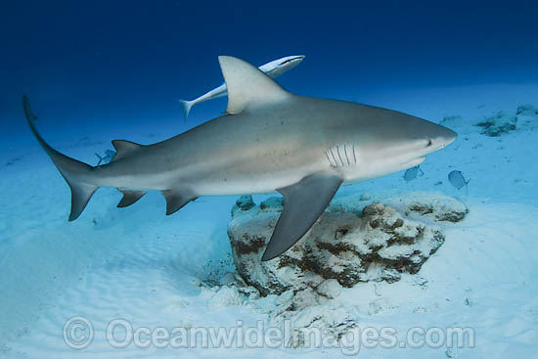
The role of non-resident sharks in shaping coral reef communities
Colin Simpfendorfer¹, Michelle Heupel^{2,1} , Andrew Tobin¹, Mario Espinosa^{1,3}
¹Centre for Sustainable Tropical Fisheries and Aquaculture, James Cook University
²Australian Institute of Marine Science
³AIMS@JCU

Slide 2
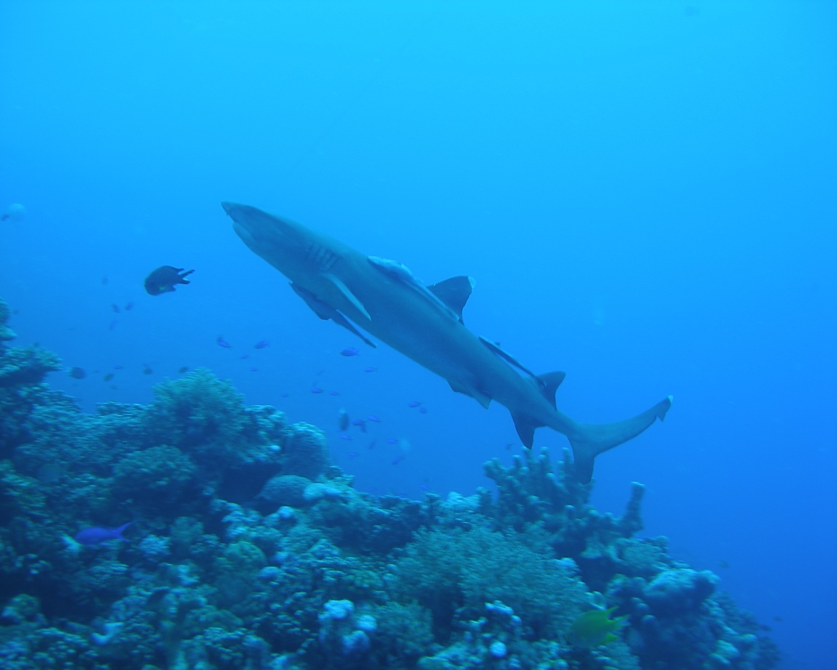
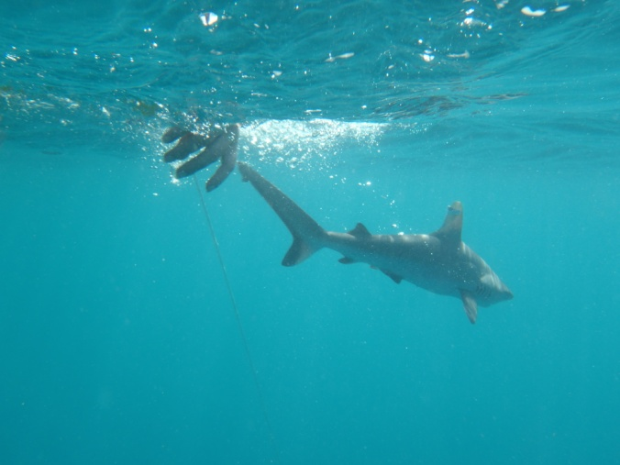
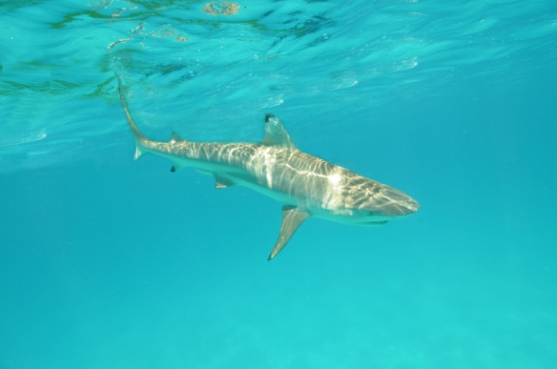
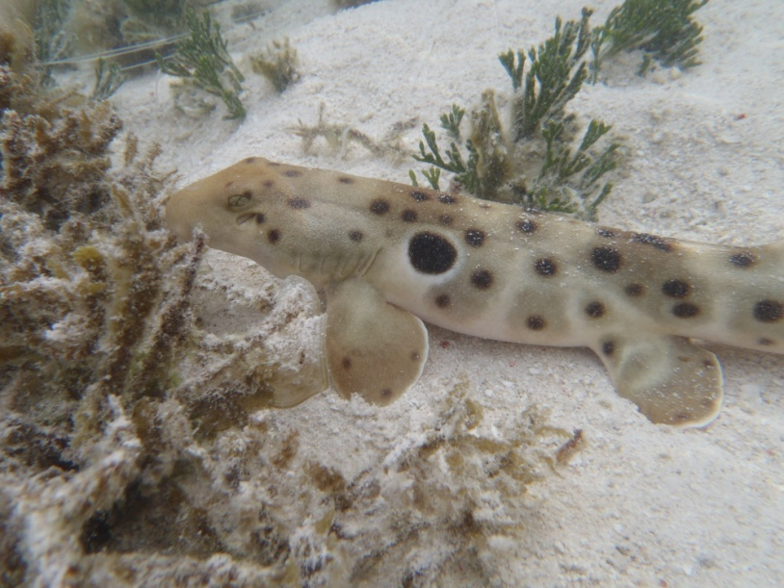
Reef-resident sharks
Whitetip shark
Grey reef shark
Blacktip reef shark
Epaulette shark

Slide 3
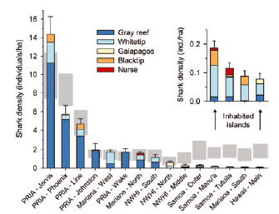
Progress on understanding reef-resident shark species
Research on their biology and ecology is increasing.
Improved understanding of movements.
Concerns over status, but varies by reef system and questions about methodologies.
Nadon, M.O., Baum, J.K., Williams, I.D., McPherson, J.M., Zgliczynski, B.J., Richards, B.L., Schroeder, R.E., and Brainard, R.E. (2012). Re-Creating Missing Population Baselines for Pacific Reef Sharks. Conservation Biology 26, 493-503.

Slide 4
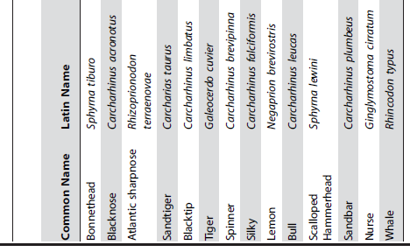
Non-resident shark species
Ward-Paige et al. 2010
14 species of shark in diver surveys
of Caribbean coral reefs.
Most more commonly observed
in non-reef areas.
Question
What role do these species play
in shaping coral reef ecosystems?
Ward-Paige, C.A., Mora, C., Lotze, H.K., Pattengill-Semmens, C., McClenachan, L., Arias-Castro, E., and Myers, R.A. (2010). Large-scale absence of sharks on reefs in the greater-Caribbean: a footprint of human presence. PLoS One 5, e11968.

Slide 5
Questions
What are the direct and indirect effects of non-resident sharks on coral reefs?
What role do coral reefs play in supporting non-resident shark species?
What are the spatial scales at which non-resident sharks connect to coral reefs?
What are the magnitudes of energy transfer to and from coral reefs by non-resident sharks?

Slide 6
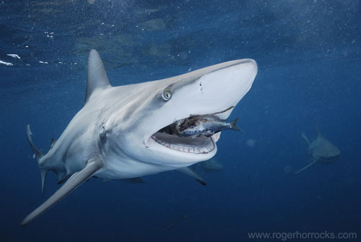
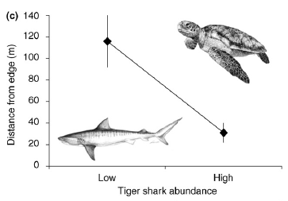
Potential roles
Direct predation
Indirect behavioural
effects
Heithaus, M.R., Frid, A., Wirsing, A.J., and Worm, B. (2008). Predicting ecological consequences of marine top predator declines. Trends in Ecology & Evolution 23, 202-210.

Slide 7
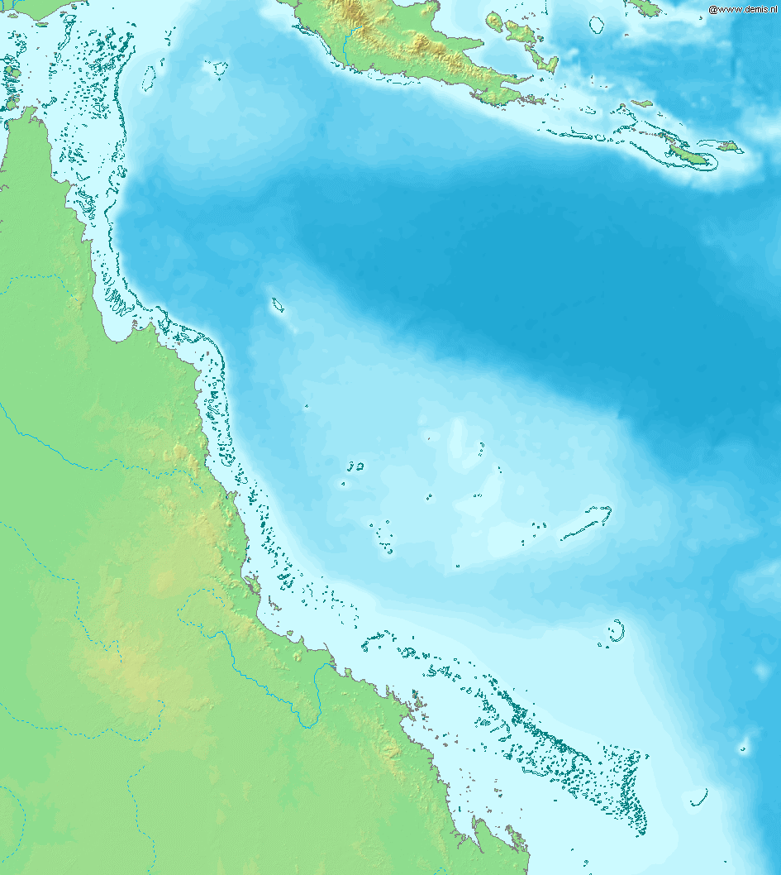
Current surveys
Townsville reefs
Cap Bunkers

Slide 8
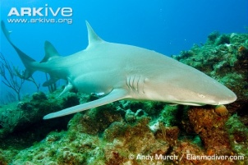
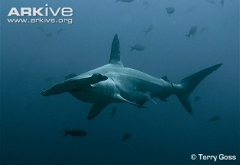
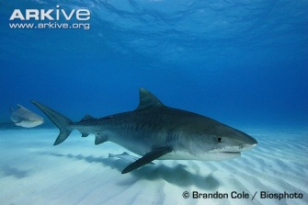
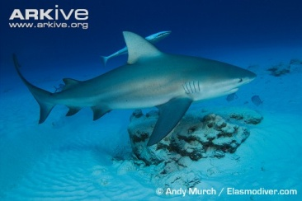
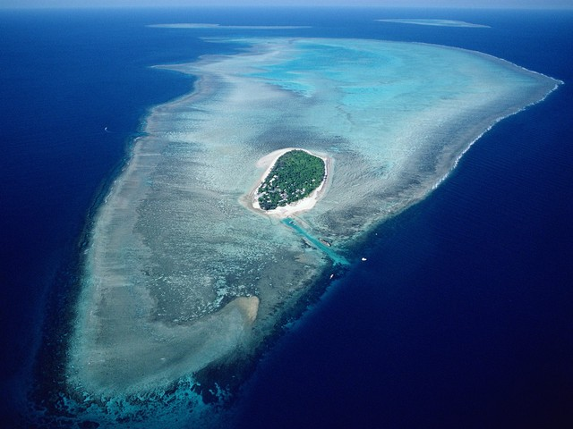
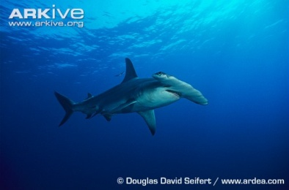
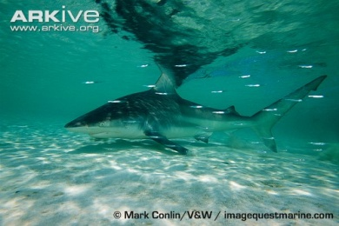
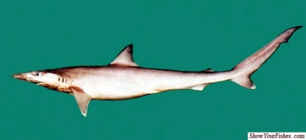
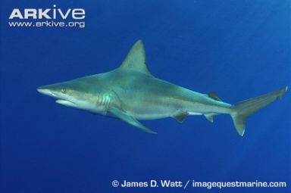
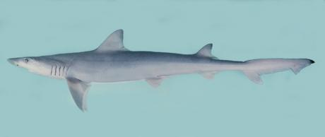
Scalloped
hammerhead
Lemon shark
Tiger shark
Bull shark
Great hammerhead
shark
Common
blacktip shark
Sliteye shark
Sandbar shark
Australian
Weasel shark

Slide 9
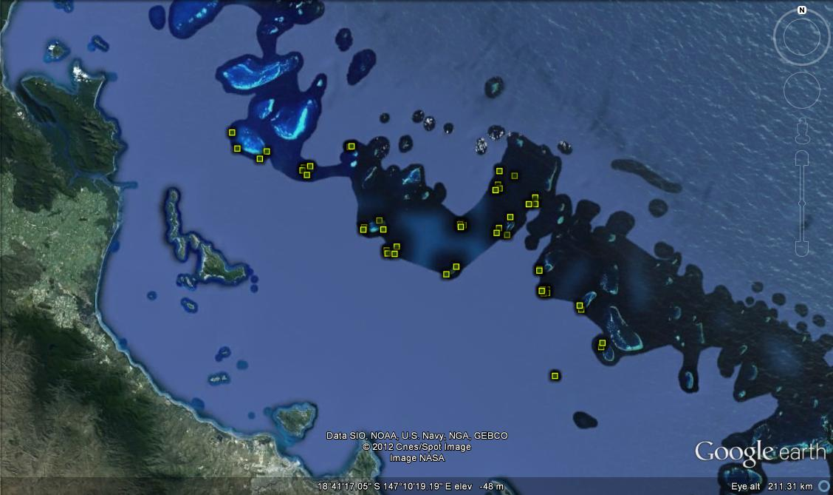
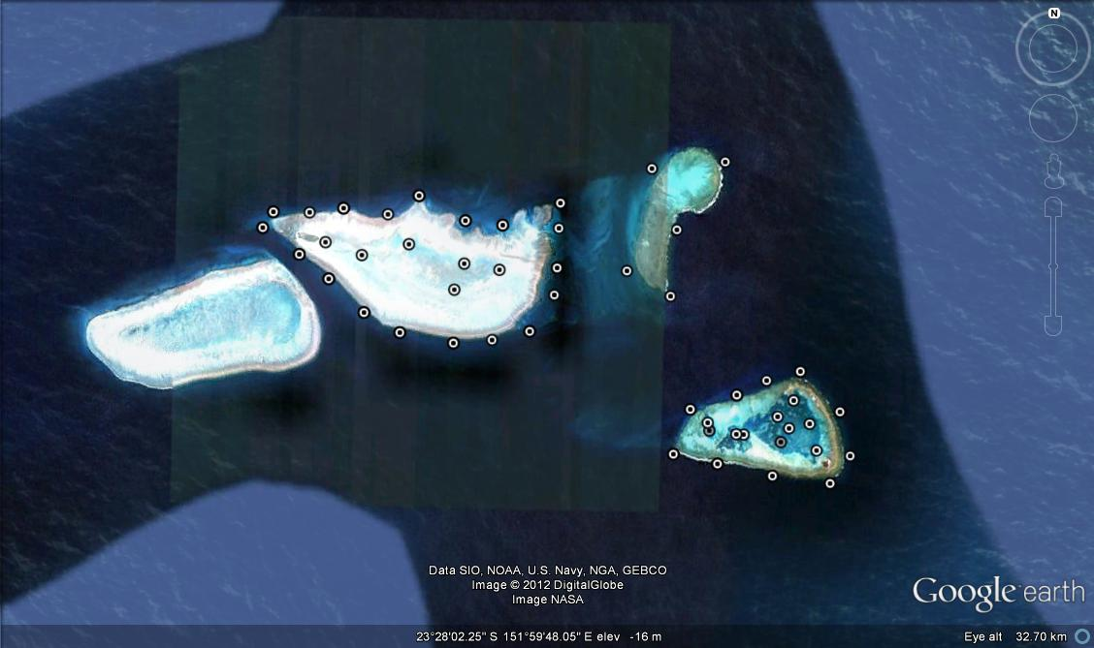
Acoustic monitoring
Townsville Reefs (n=48)
CapBunkers (n=50)

Slide 10
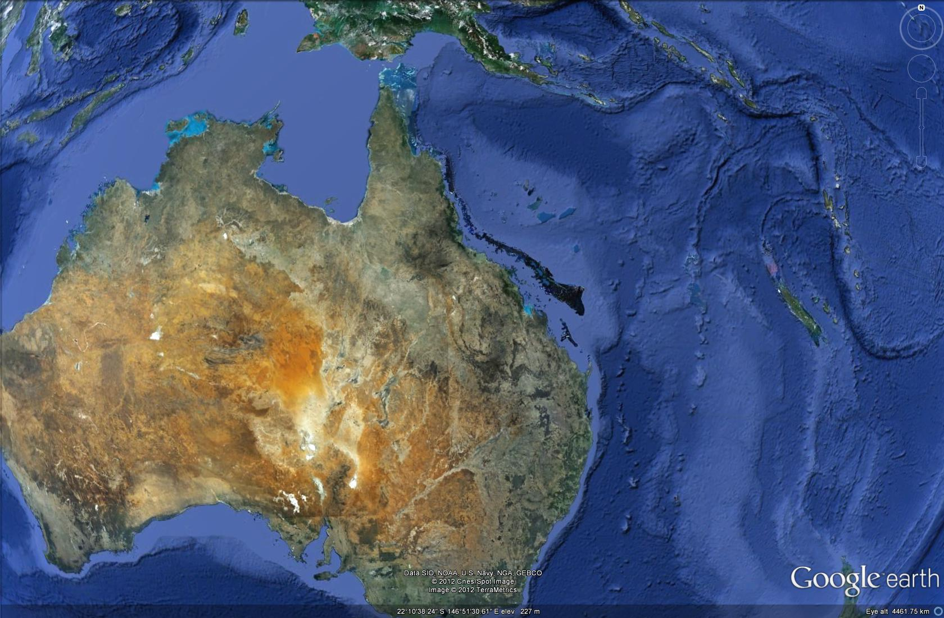
1. Seasonal invaders
8 bull sharks from NSW detected
on acoustic receivers in the GBR
Demonstrates long distance
movements to coral reefs and
potential energy flows
Other species:
White sharks
Reef manta
Data from NSW Fisheries – Vic Peddemores, Amy Smoothey

Slide 11
2. Individual reef specialists
Individuals show high level of site fidelity to reef
Species as a whole show use of wide range of habitats, not just reefs
Consistent with reports of individual diet specialisation in some shark species (Matich et al. 2011)
Matich, P., Heithaus, M.R., and Layman, C.A. (2011). Contrasting patterns of individual specialization and trophic coupling in two marine apex predators. Journal of Animal Ecology 80, 294-305.

Slide 12
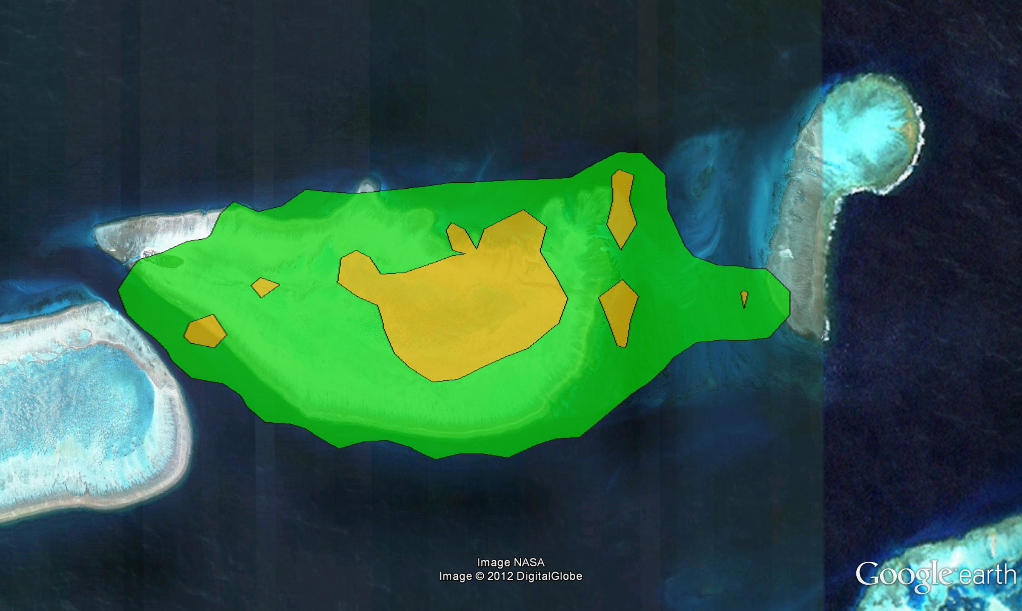
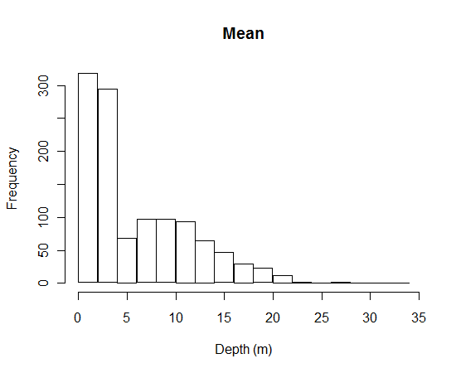
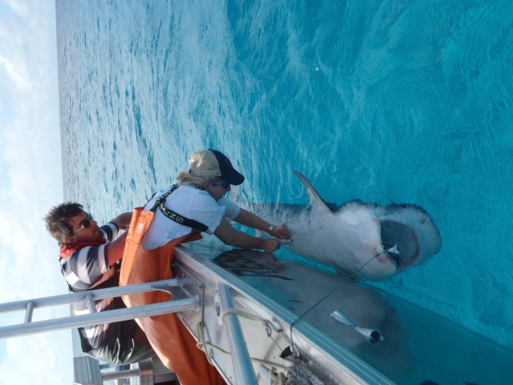
Tiger shark
Detected 93% of days over six month period

Slide 13
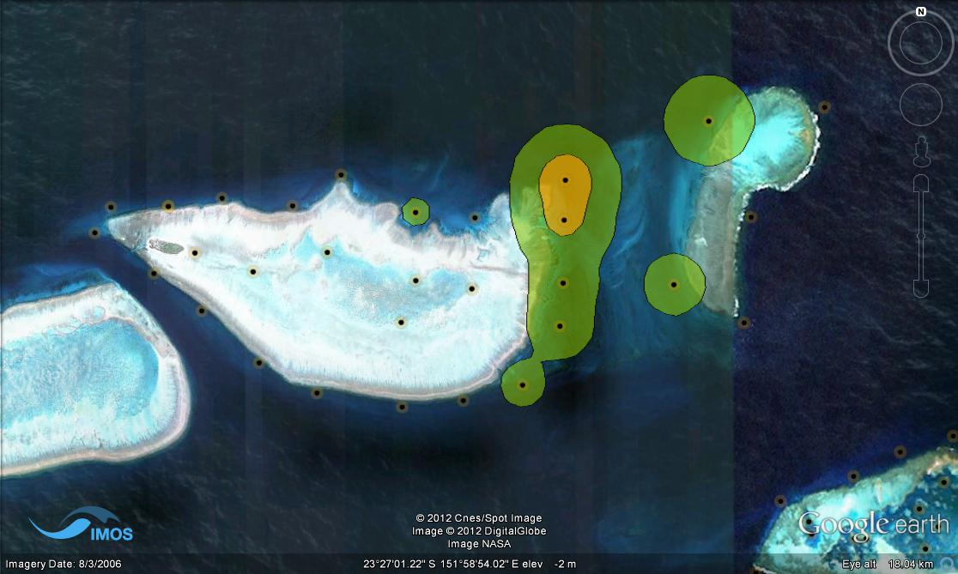
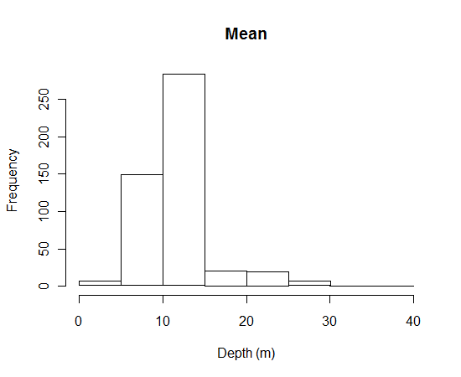
Australian weasel shark
Detected 69% of days over six month period

Slide 14
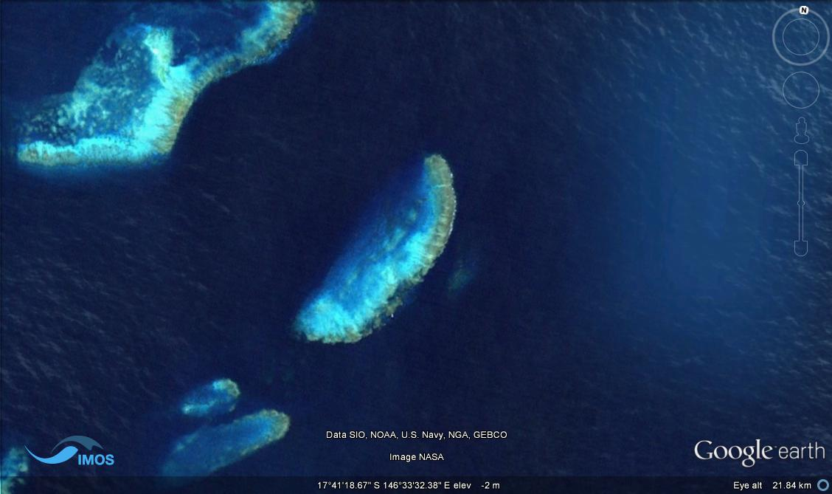
3. Nocturnal invaders
Night
Day

Slide 15
Sliteye shark
Occupy areas relatively close to reefs during the day.
Enter reef habitats at night, possibly to feed.
Sliteye shark

Slide 16
Occasional invaders
Only interact with reefs occasionally.
Probably have limited affect on reef communities
Great hammerhead
Common blacktip

Slide 17
Scalloped
hammerhead
Lemon shark
Tiger shark
Bull shark
Great hammerhead
shark
Common
blacktip shark
Sliteye shark
Australian
Weasel shark
Sandbar shark
Seasonal
Individual specialist
Occasional
Noctural

Slide 18
Role of non-resident reef sharks
Individual
Specialist
Level of
effect on
reef
community
(% time
in reef
ecosystem)
Nocturnal
invader
Seasonal
Invader
Occasional invader
Distance of energy flow

Slide 19
Conclusions
The effects of non-resident sharks on reef communities can be both direct and indirect.
Non-resident sharks interact with reef communities in a variety of ways
Not just reef resident sharks that have predator roles.
Energy flows occur over both short and long distances

Slide 20
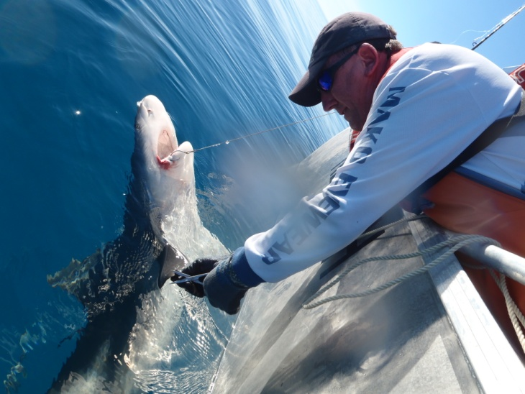
Next steps
Continue surveys
Continue acoustic telemetry work
Use stable isotopes to investigate trophic roles
Student engaged on the project (Mario Espinoza)

Slide 21
Thanks
ARC (MRH Future Fellowship)
NERP Tropical Ecosystems Hub (Project 6.1)
Heron Island Research Station
RV James Kirby

